Slide 1
URD Database Project
May 29, 2026

Slide 2
Agenda
Introductions
URD Mission and Process Overview (Juliana)
Database Project Overview (Jon)
Next Steps – Requests (Jon)

Slide 3
URD Mission and Process Overview
Mission:
Acquire and preserve Jewish Ukrainian genealogical records.
Process:
Entails monitoring archives for changes, identifying relevant documents, acquiring the documents, and extracting the metadata.
Involves a volunteer team using a central set of Google Drive spreadsheets to manage and track the data.
Scale has grown to many thousands of documents, with a growing influx of new documents to be processed every day.

Slide 4

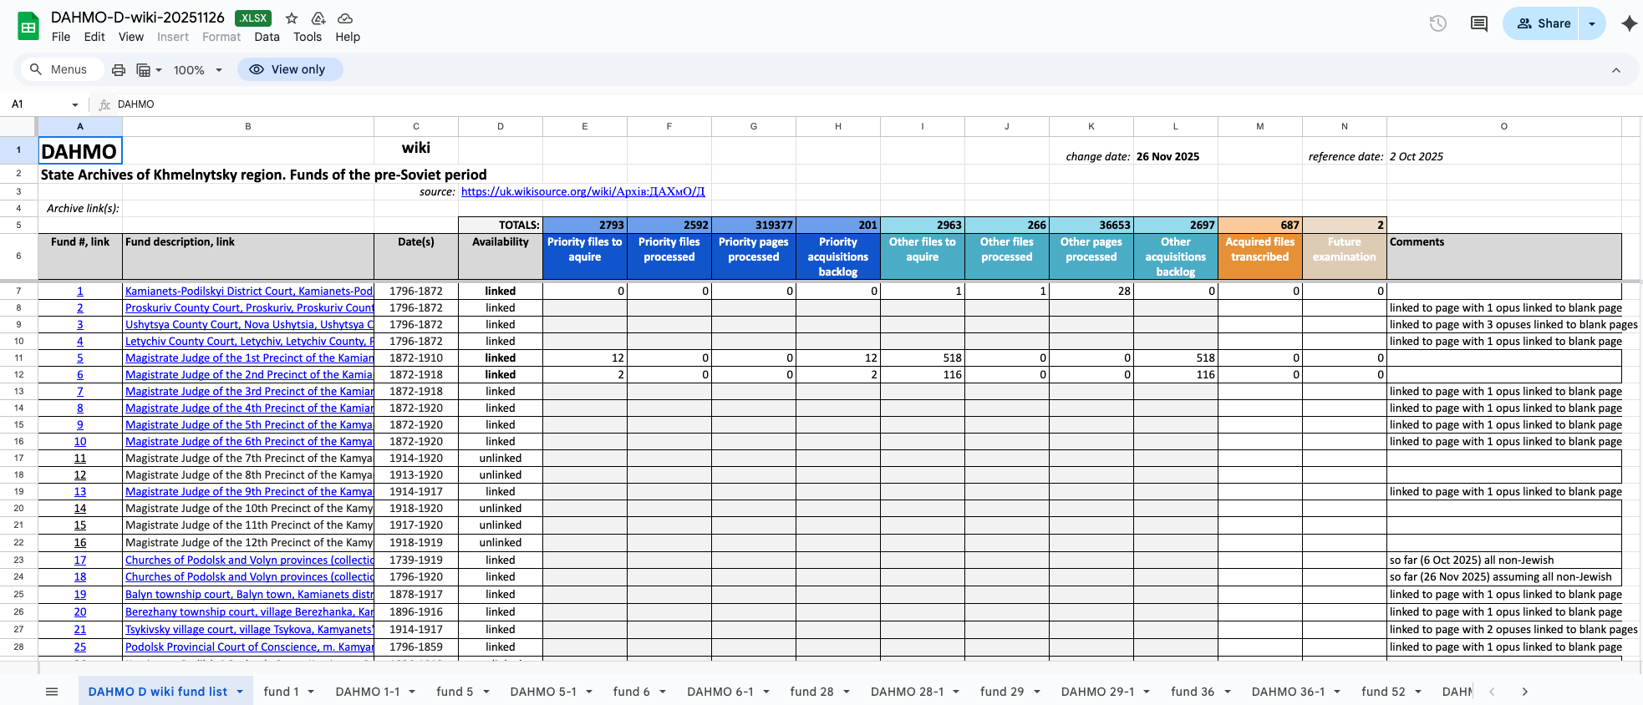
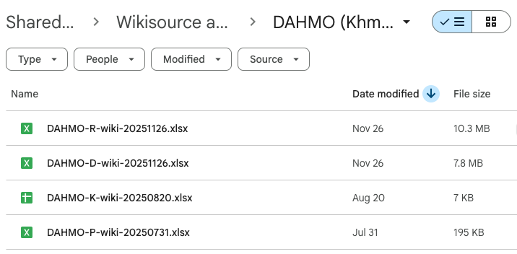
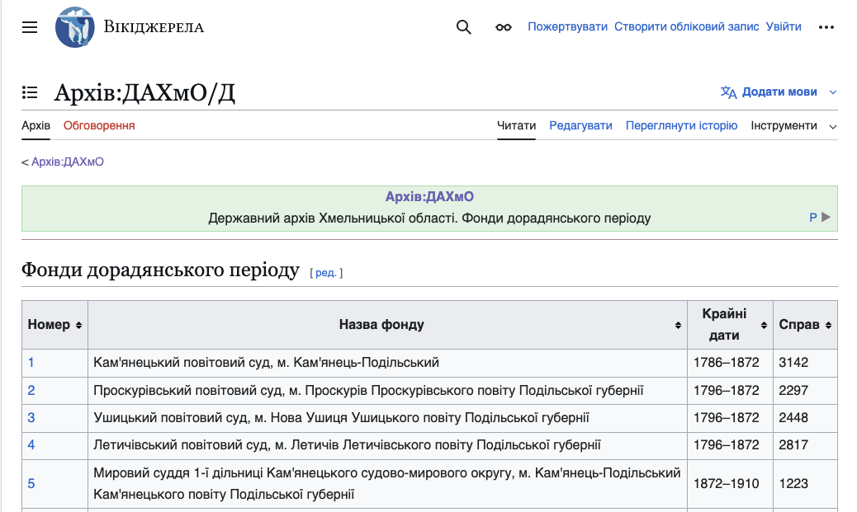

JewishGen URD Birds-Eye View

Slide 5
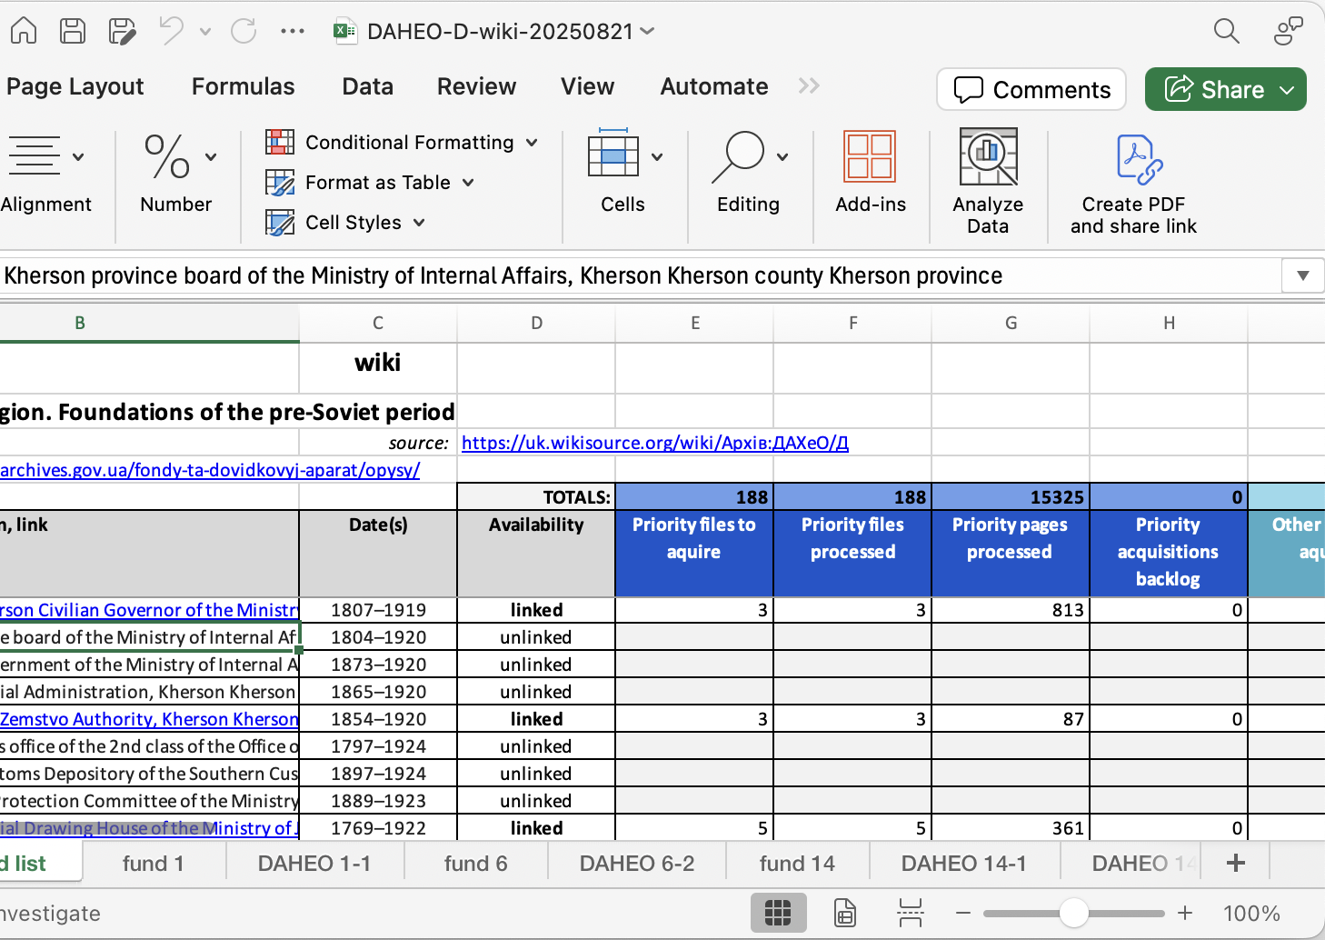
URD Data Problem
With Google Drive spreadsheets,
View and Data are not separated
Labor intensive to maintain
Fragile multi-tab relationships
Not amenable to multi-person access
Hard to revise sheet structure
Hard to scale

Slide 6

Proposed Solution
Replace Google Drive with a Database that
Separates data from view
Is easy to maintain and evolve
Can scale
Correctly handles multiple concurrent users
Replaces multi-tab spreadsheets with evolvable, role-specific views
Replaces cross-sheet process reporting formulas with automated roll-ups
Provides built-in back-up, journaling of data changes, and commenting
Facilitates further automation, such as AI-assisted triage, etc.

Slide 7
Database Requirements
Low cost
Multi-user
Easy learning curve
Sufficient variety of views
Coexists with Birddog and Google Drive
Easily grow and transform with evolving needs
No lock-in: possible to migrate out down the road
Role-based access rights

Slide 8
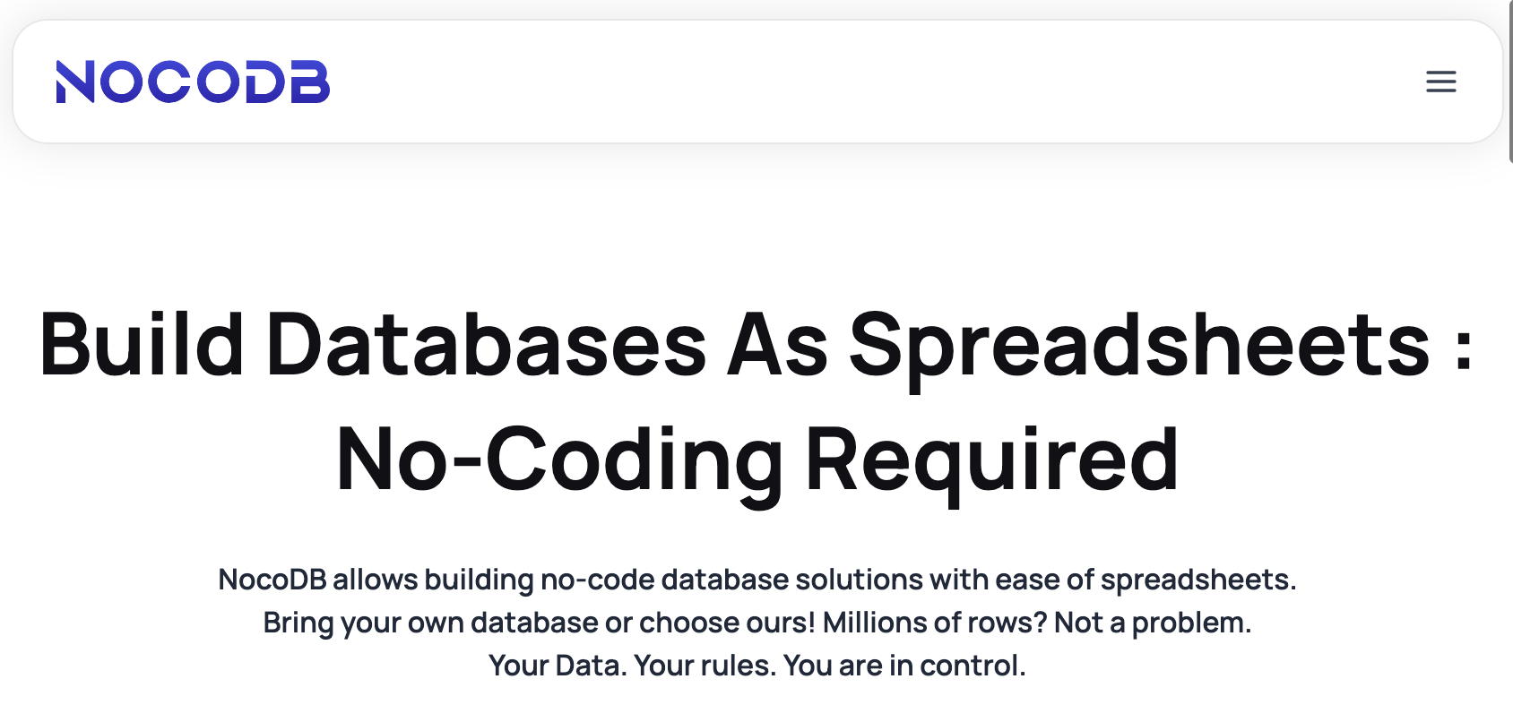
Proposed Platform: NocoDB
Low cost
Easy to learn (like AirTable)
Opensource
Open database
Available as hosted solution
Can be self-hosted too
https://nocodb.com/

Slide 9
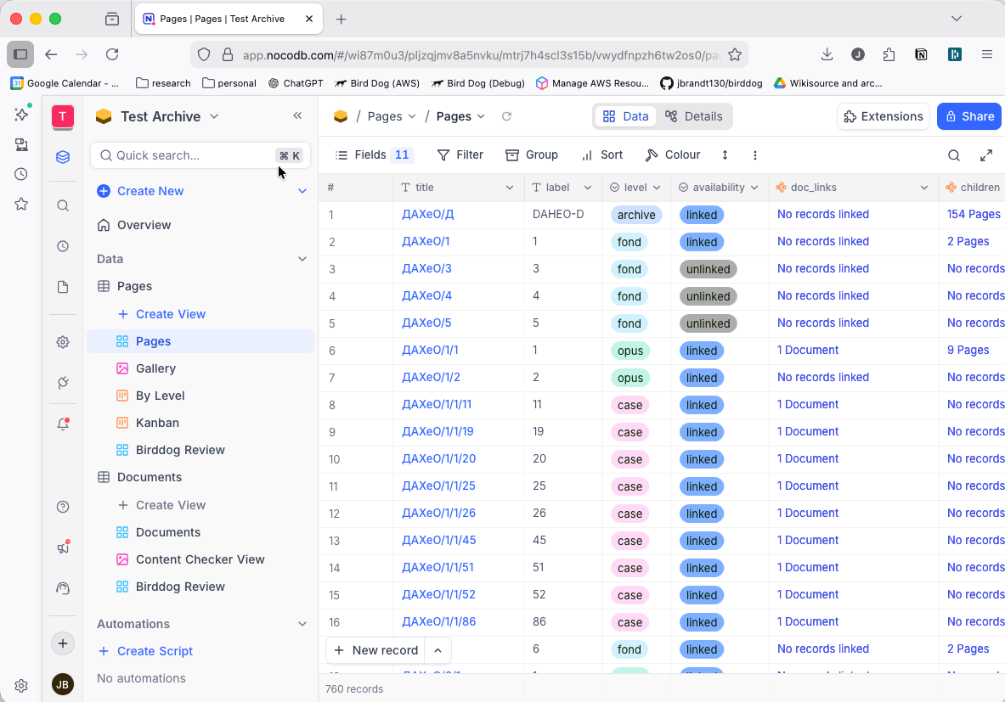
NocoDB Web App

Slide 10
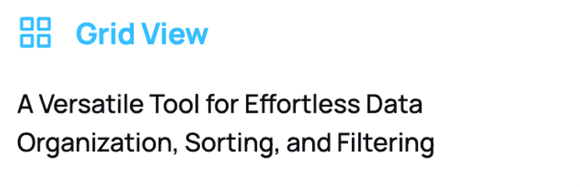
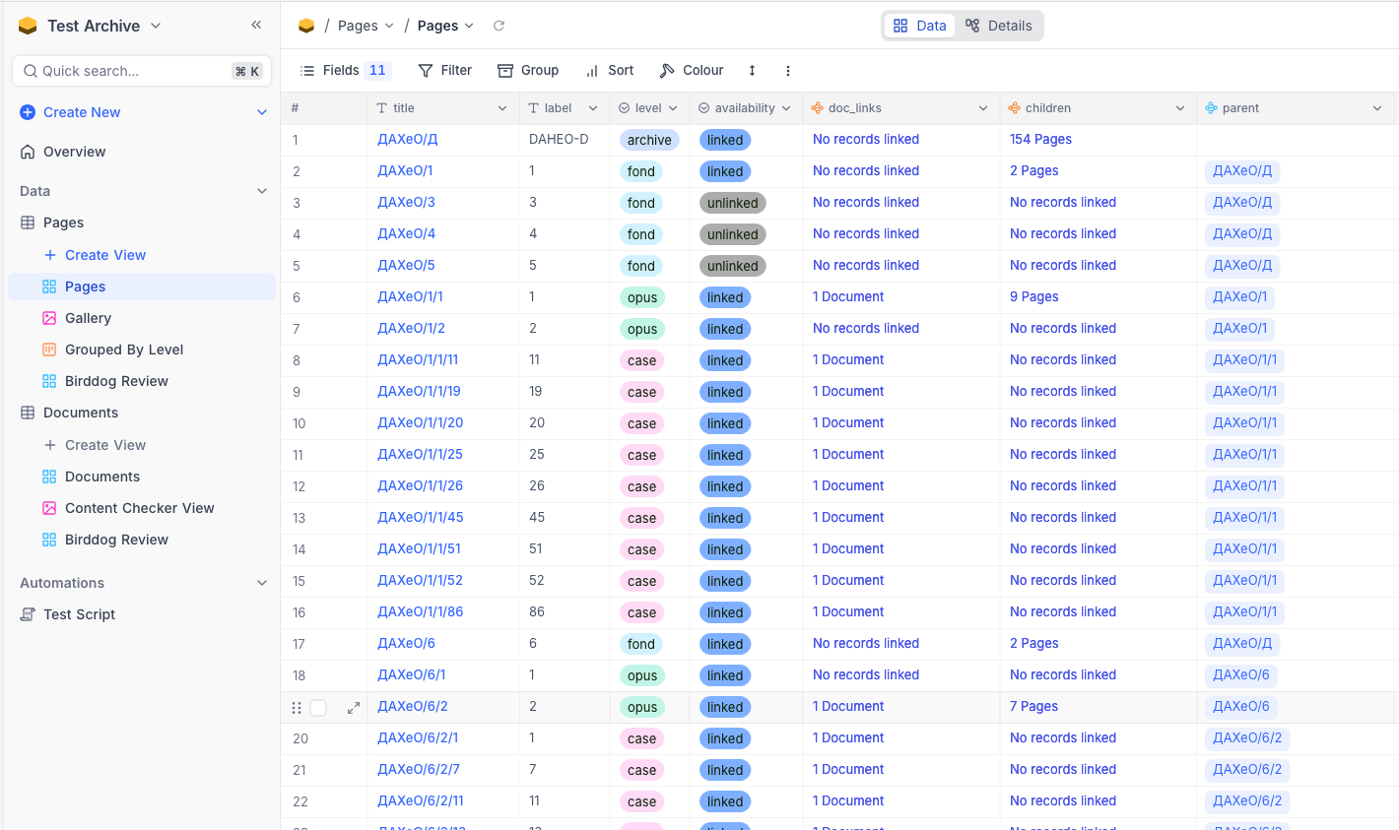
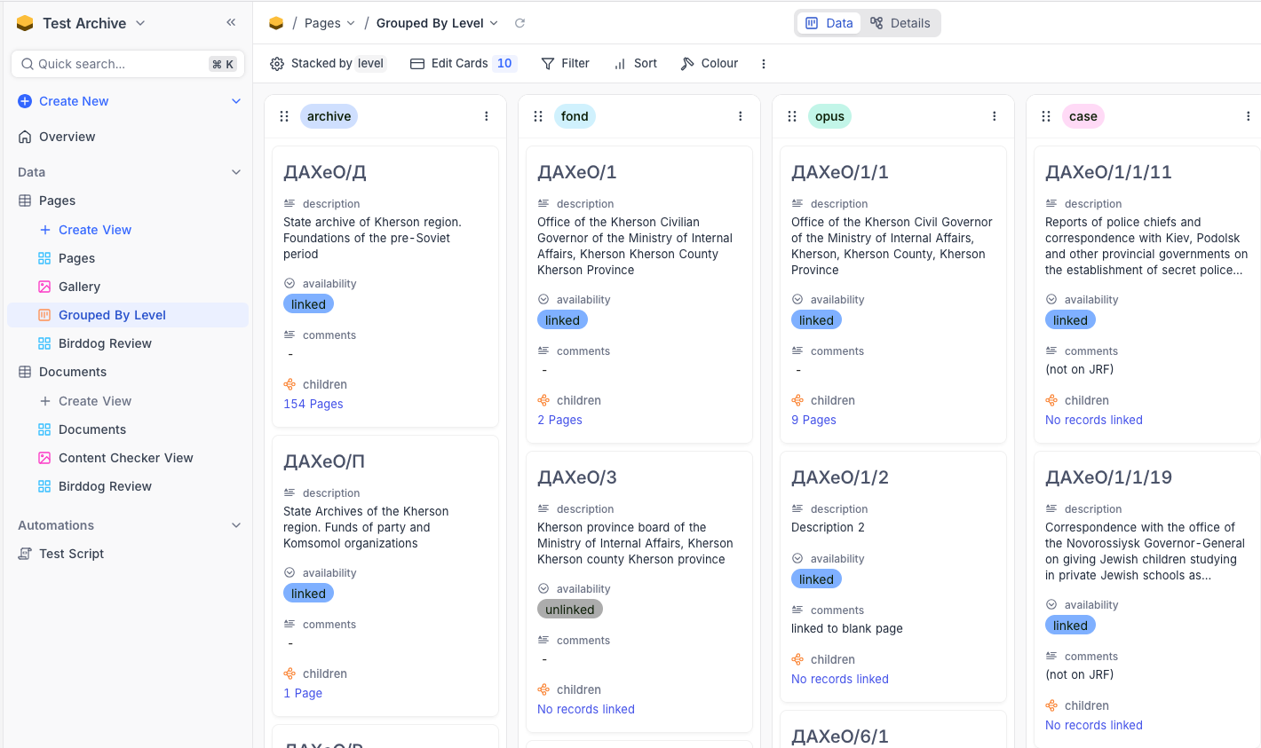
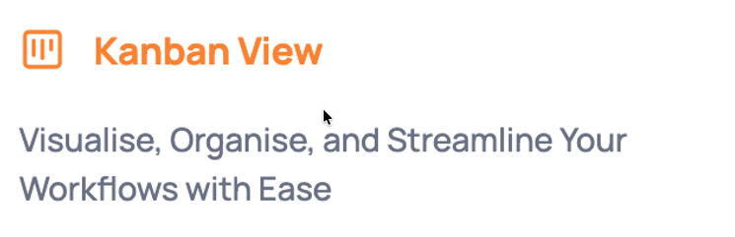

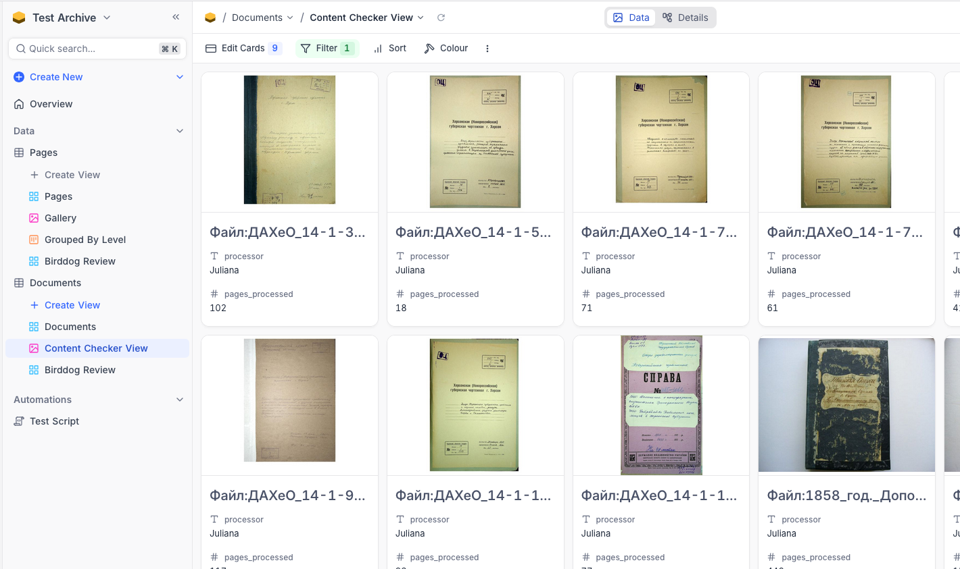
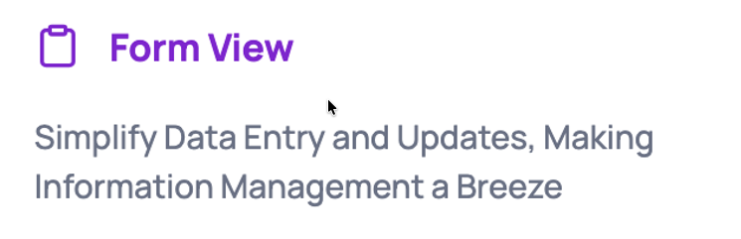

Customizable Views

Slide 11
Database Project Goals
1. Increase efficiency through technology and workflow improvements
2. Build a structured and scalable acquisition infrastructure
3. Strengthen organizational capacity and volunteer infrastructure
4. Ensure data integrity and quality standards

Slide 12


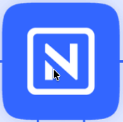
Development Strategy
Ongoing Work
Google Drive
Database development work began in December 2025 using a self-managed Nocodb instance.
Wikisource
Birddog
Validate the platform choice incrementally.
Information gathering from team(s)
Birddog integration experiments
Identify and flesh out roles and views
Develop in parallel with ongoing Google Drive-based workflows.
Transition when we’re ready.
Snapshots
Database
Database Development

Slide 13

Development Status
Ongoing Work
Google Drive
Wikisource
Birddog
Snapshots
Birddog Integration - automatic updates from Wiki
Data import from spreadsheets
Database
Database Development
Workflow development (views, roles, streamlining)
Transition the URD process to the database platform

Slide 14
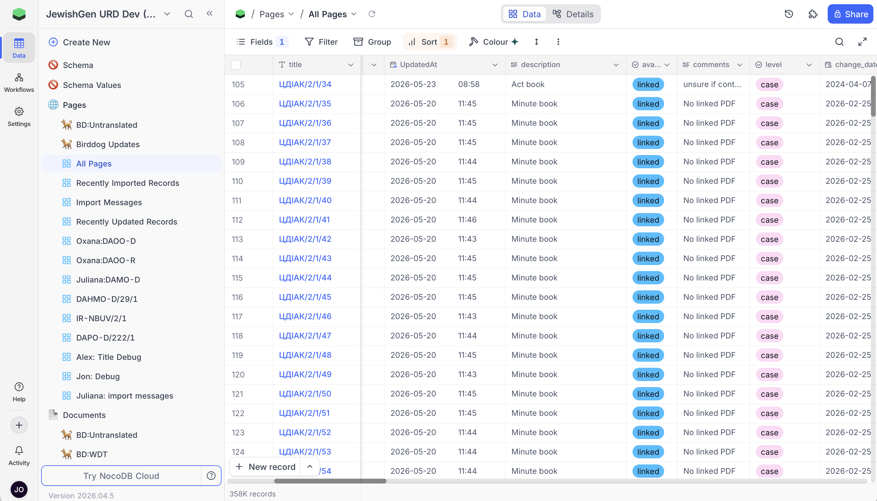
Database Status
358k Page records
171k Document records

Slide 15
Transition Steps
Migrate Birddog application into JewishGen IT infrastructure.
AWS deployment
Integrate JewishGen identity management
Migrate database to Nocodb cloud hosting.
Establish Enterprise cloud hosting plan
Data migration
Roles / permissions implementation
Onboard and train the team.
Establish an ongoing tech operations process.

Slide 16
Needs to Move Forward

Slide 17
Needs to Move Forward
1. JewishGen IT technical contact for Birddog migration
Assistance with JG-hosted AWS EC2 deployment
Assistance with integration of JG identity management into Birddog
Absorb ongoing Birddog operating costs (currently $30/month)

Slide 18
Needs to Move Forward
2. Support to establish Nocodb Cloud Enterprise plan
Business liaison to establish enterprise license
Technical support for integration with JG identity management
Ongoing license payments (estimated to be ~$200-400/month)

Slide 19
Needs to Move Forward
3. JewishGen IT partnership for ongoing operations
IT contact for Birddog operations issues
IT contact for Nocodb operations issues

Slide 20
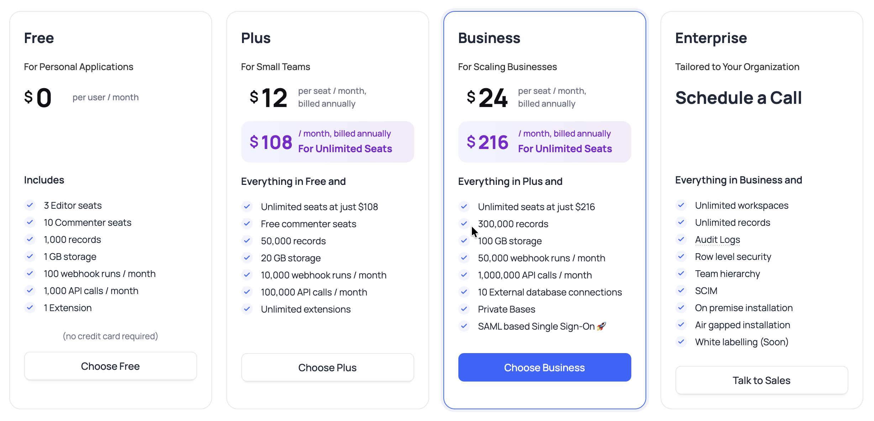
NocoDB Cloud Hosting Plans

Slide 21
Database Schema
Separate Page data from Scanned Document data
“Page”
A Wiki or Archive web page
Title
URL
Level (archive, fund, opus, case)
Availability (linked, unlinked)
Parent (page)
Children (pages)
Documents
“Document”
An attached scanned document
Document link
Document type
Content code
Process code
Processor
Pages processed
Owning page

Slide 22
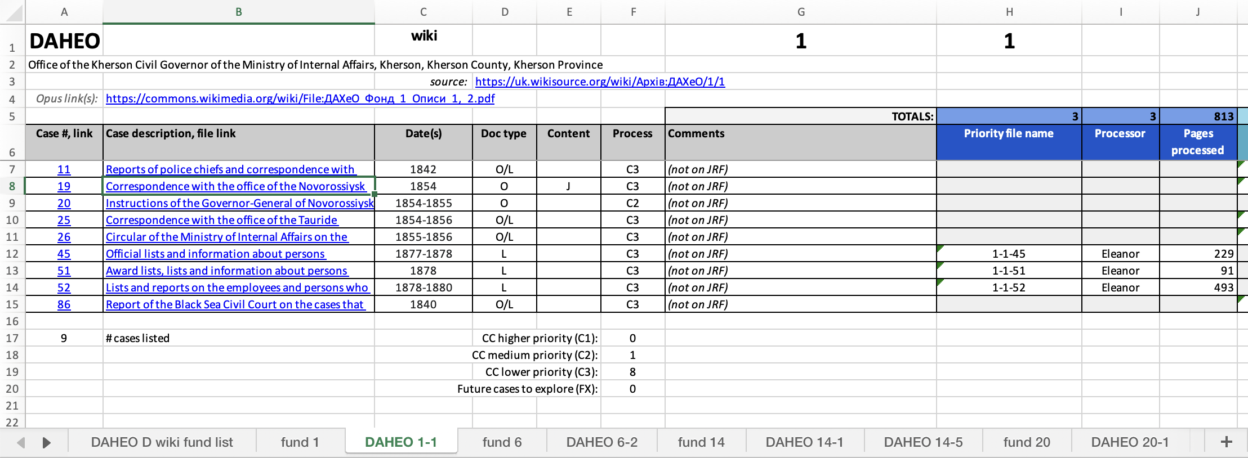
Mapping Spreadsheet Columns to Database Schema
Page Data
Document Data
Document Links

